Slide 1
SMART INSOLE
Solving the Problem of Finding the Right Footwear

Slide 2
Problem Statement The Need for Personalized Shoe Solutions
The Lack of Personalized Shoe Solution
Generic footwear does not cater to individual needs
The Challenge of Finding the Right Footwear for Various Activities
Limited options for personalized shoe solutions

Slide 3
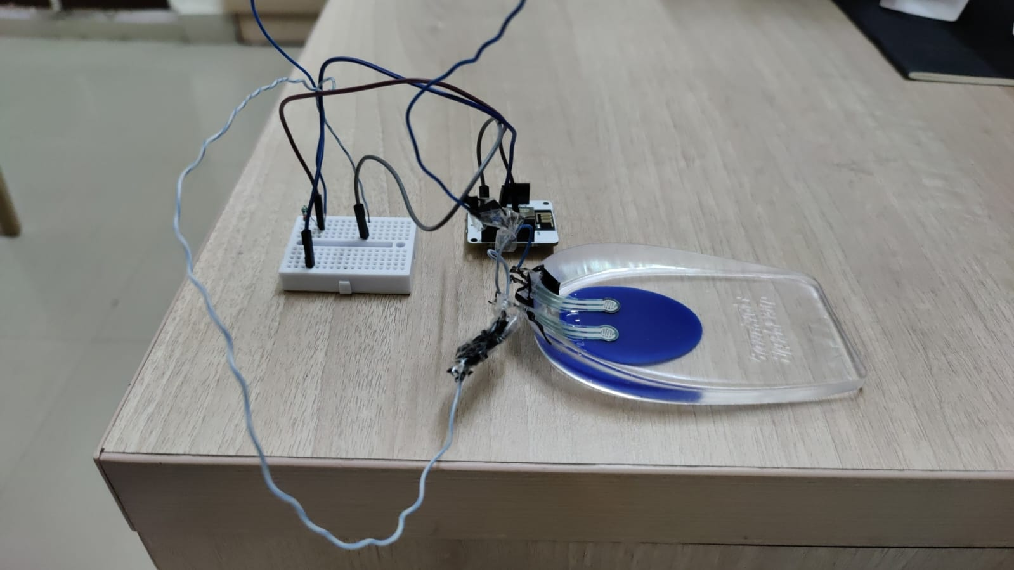
This project acknowledges the diverse challenges faced by these user groups and aims to provide comprehensive solutions.
DATA ACQUISITION:
Customers can use information collected by sensors to select shoes best for them in offline mode which can be stored on a database according to corresponding size, activity and region for various purpose.

Slide 4
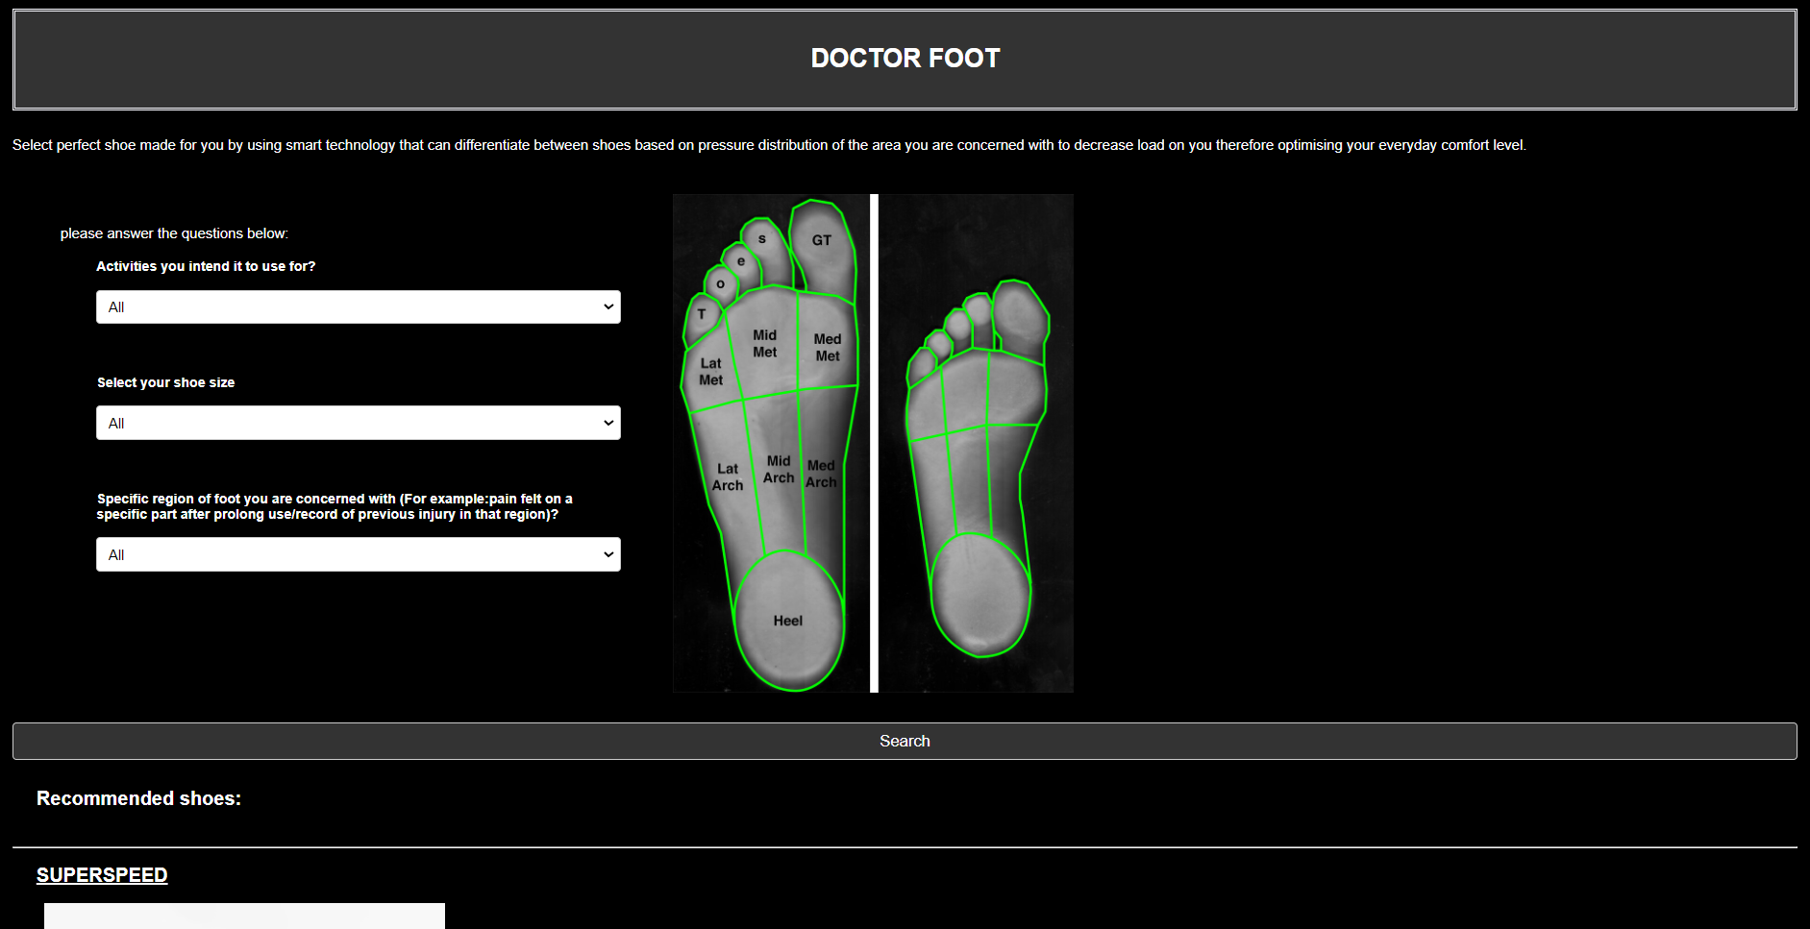
SMART FILTER
Web-based platform that brings forth an innovative approach to footwear selection by considering the unique aspects like weight distribution of specific regions and activities.
The Smart filter website filters shoes based on weight distribution data collected by pressure sensors for various regions and for shoes of different sizes.

Slide 5
RELEVANCE TO DECATHLON Enhancing Customer Experience through Partnerships
01
Decathlon's Mission to Make Sports Accessible to all
Aligning with company's core values
Personalized Footwear and Injury Prevention
Contributing to Decathlon’s commitment to customer safety.
Competitive Advantage
Because of its unique attribute to take account of pressure distribution it can give Decathlon a
competitive edge in sports retail industry.
Alignment with Sustainability
Personalized footwear can contribute to sustainability by offering shoes tailored to individual
needs, Decathlon can reduce overproduction and waste, aligning with sustainability goals.
02
03
04

Slide 6
Expected Impact on Stakeholders Enhancing Footwear for a Better Experience
Stakeholder
Impact
Users(Athletes, Older Individuals, General Population)
- Improved comfort and safety, Enhanced sports performance, Reduction in
foot-related injuries, More enjoyable physical activities
Decathlon
- Increased customer satisfaction and loyalty, Higher sales and revenue, Positive
brand image and innovation, Contribution to Decathlon’s mission
- Promotion of foot health and well-being, Reduced healthcare costs related to foot I injuries, Innovation in footwear design and manufacturing,
A safer and more comfortable environment for sports and physical activities.
Society

Slide 7
Conclusion
Overcoming Roadblocks and Challenges
-Ensuring accurate foot measurements
-Balancing customization with cost-effectiveness
Measuring Success
-Customer satisfaction surveys
-Increase in sales and revenue
-Reduction in
foot-related injuries

Slide 8

THANK YOU Lets Revolutionize Footwear Together!
This Photo by Unknown Author is licensed under CC BY-SA-NC

Slide 9
QUESTIONS?

